Slide 1
Lecture 1
CV Defined
A brief History
Image Types and Representation

Slide 2
Definition
“Computer vision is concerned with the automatic extraction, analysis & understanding of useful information from a single image or a sequence of images. It involves the development of a theoretical and algorithmic basis to achieve automatic visual understanding.”
Attributed to The British Machine Vision Association and Society for Pattern Recognition
The goal of Computer Vision is to make useful decisions about real physical objects and scenes based on sensed images.
by Shaprio & Stockman
Computer vision is concerned with the visual perception part: it is the science of perceiving and understanding the world through images and videos by constructing a physical model of the world so that an AI system can then take appropriate actions.
By Elgendy
Computer Vision uses cameras to analyze or understand scenes in the real world.

Slide 3
Computer vision is the automated extraction of information from images. Information can mean anything from 3D models, camera position, object detection, and recognition to group and search image content. [Solem]
Practical computer vision contains a mix of programming, modeling, and mathematics and is sometimes difficult to grasp.

Slide 4
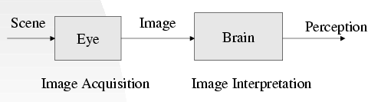
Vision
“Vision is the process of discovering from images what is present in the world and where it is” – David Marr

Slide 5
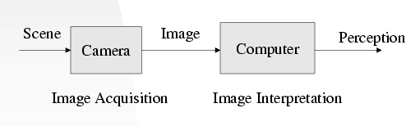
Computer Vision
Computer Vision is the study of analysis of pictures and videos (using computers) in order to achieve results similar to those as by human.

Slide 6
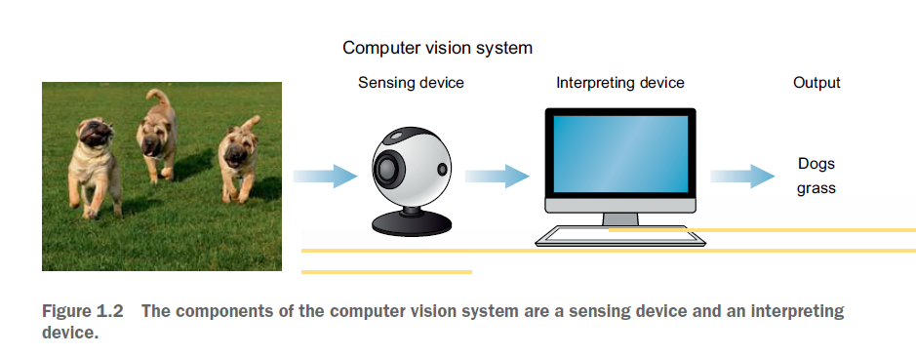

Slide 7
An Example
Problem: Given an image I, finding people in images
Question: Does I contain an image of a person?

Slide 8

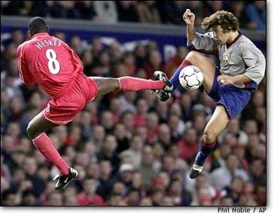
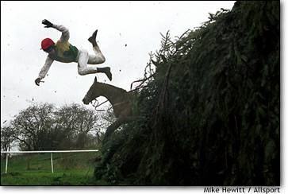
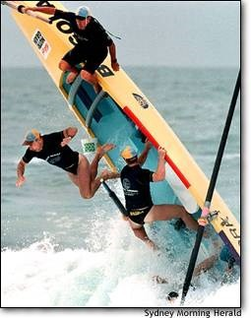
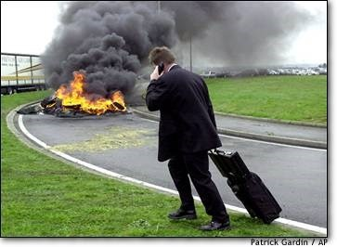
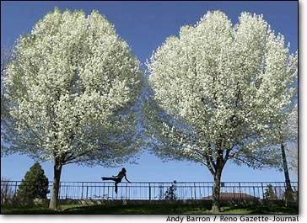
“Yes” Cases

Slide 9
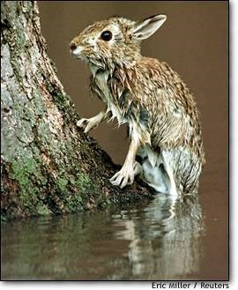
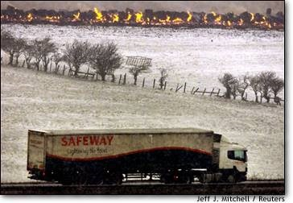
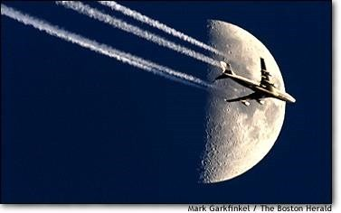
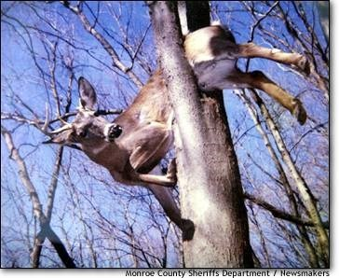
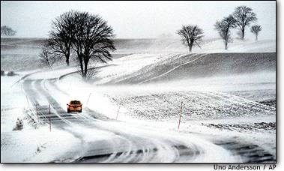
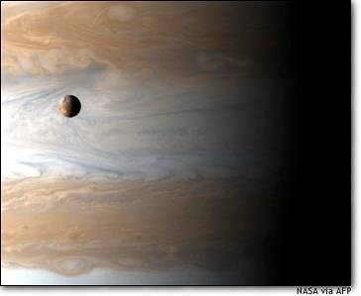
“No” Cases

Slide 10
The Nature of This Course
This is a multi-disciplinary course
Computer vision has applications in many fields, such as medicine, military, internet, library, etc.
Computer-vision research involves tools from many fields, such as signal processing, physics, mathematics, psychology, geometry, optics, color science, graphics, optimization, artificial intelligence, machine learning, etc.
It is a very challenging but important problem in computer science, and many computer-vision problems are open problems
It is not a very well-established discipline such as physics and calculus, many topics are application-oriented
Linear algebra, probability and statistics are very widely used in computer vision for building many vision models

Slide 11
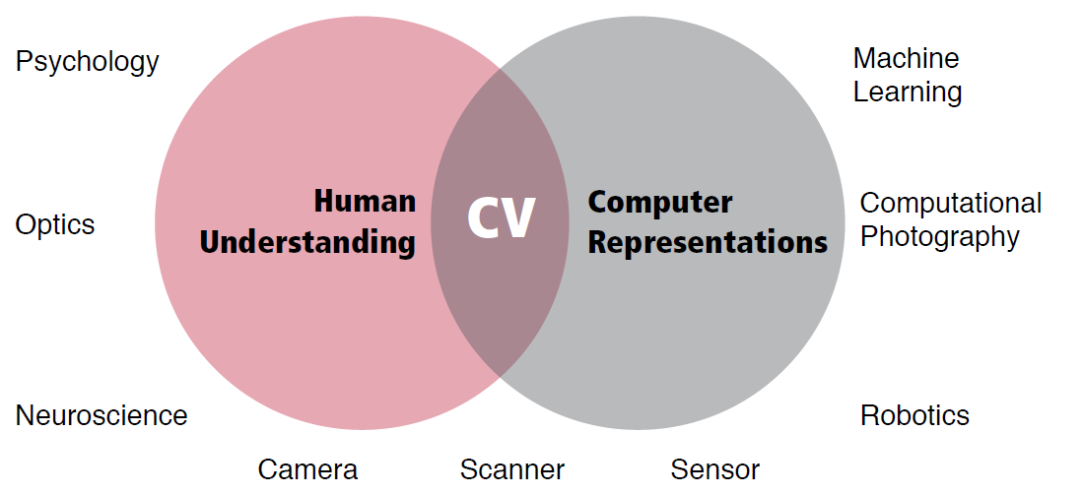
Multidisciplinary

Slide 12
Vision vs Graphics
Vision: from image to model/perception (analyzing image)
Graphics: from model/perception to image (constructing image)
So they are inverse and correlated processes
Vision
Graphics
Human vision always see the world with prior model (knowledge) in the mind
Models are usually important in vision
Problem is how to incorporate the model into the image
understanding process

Slide 13
Related Areas
Computer vision overlaps with image processing, and machine learning significantly.
Image processing: operations are usually performed from image to image including compression, restoration, and enhancement
Machine learning: development of computer algorithms to automatically learn models from data (experience) and improve prediction/decision making
Image processing and machine learning are important tools
used in computer vision.

Slide 14
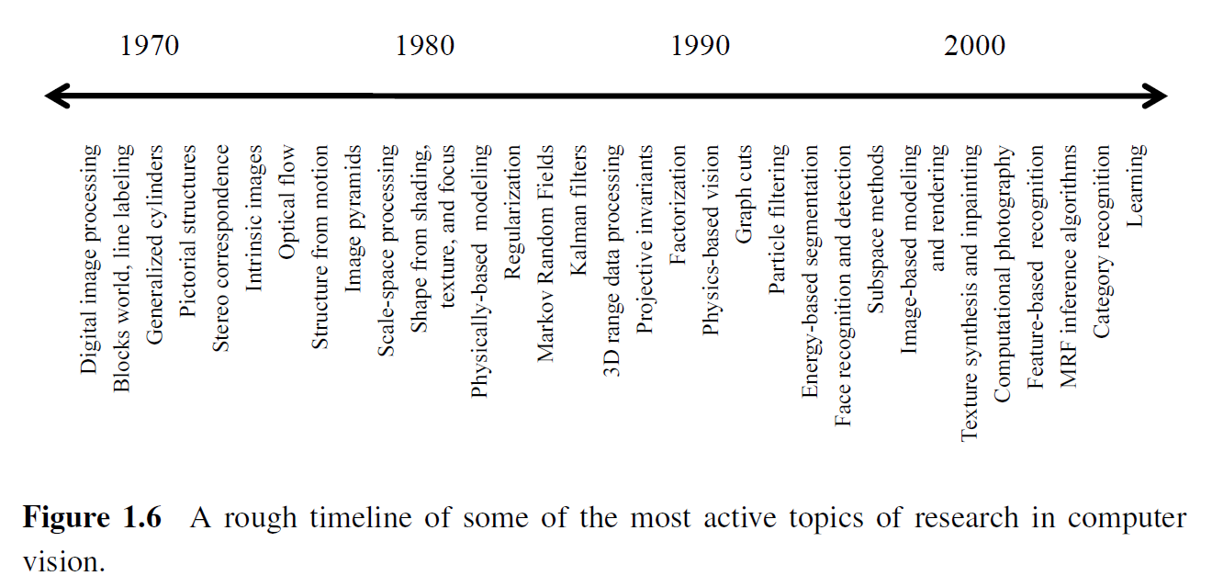
A brief History
Source: Richard Szeliski

Slide 15

Hierarchy of Computer Vision Problems
Computational model of camera
Radiometry
Camera calibration, etc.
Sensing: Image
Knowledge integration level
Early Vision: Low Level Information
Single image: filters, edges, features, etc.
Multiple images: stereo vision, motion analysis, etc.
Segmentation and grouping Object tracking, etc.
Mid-Level Vision: Mid-Level Information
High-Level Vision: High-Level Information/Understanding
Object recognition Scene understanding Image interpretation, etc.

Slide 16
Imaging Devices
Monochrome Camera
Colored Camera
Video Cameras
Satellite Imagery(infrared, visible, water vapor)
X-rays
CT and MRI
Ultrasound

Slide 17
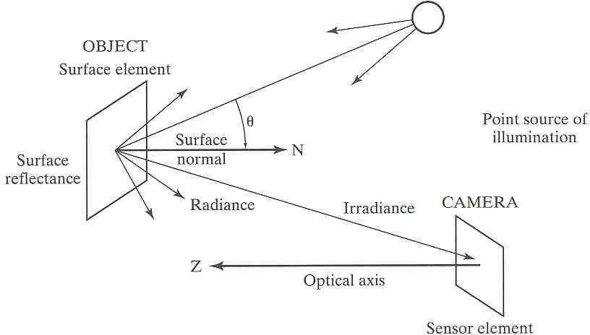
Some Problems in Computer Vision: Imaging Process
Imaging process
Light reaches surfaces in 3D
Surfaces reflect light
Sensor element receives light energy
Factors
Intensity of energy
Surface roughness
Surface material
Issues
Shadow and occlusions

Slide 18
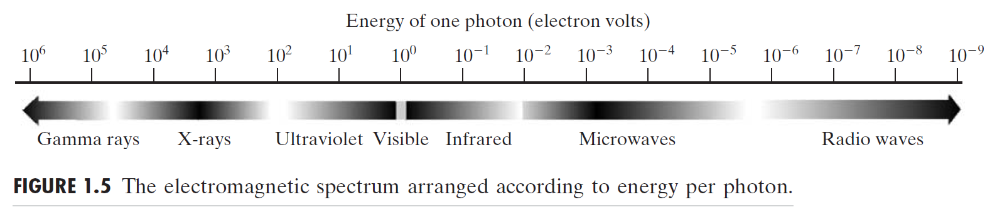
Examples of Fields that use Digital Image processing
Image processing applications: To categorize images according to their source (e.g., visual, X-ray, and so on).
copyright: Gonzalez & Woods

Slide 19
Electromagnetic Spectrum
Images based on radiation from the EM spectrum are the most familiar, especially images in the X-ray and visual bands of the spectrum.
Electromagnetic waves can be conceptualized as propagating sinusoidal waves of varying wavelengths, or they can be thought of as a stream of massless particles, each traveling in a wavelike pattern and moving at the speed of light.
Each massless particle contains a certain amount (or bundle) of energy. Each bundle of energy is called a photon.
copyright: Gonzalez & Woods

Slide 20
If spectral bands are grouped according to energy per photon, we obtain the spectrum shown in Fig. 1.5, ranging from gamma rays (highest energy) at one end to radio waves (lowest energy) at the other.
copyright: Gonzalez & Woods

Slide 21
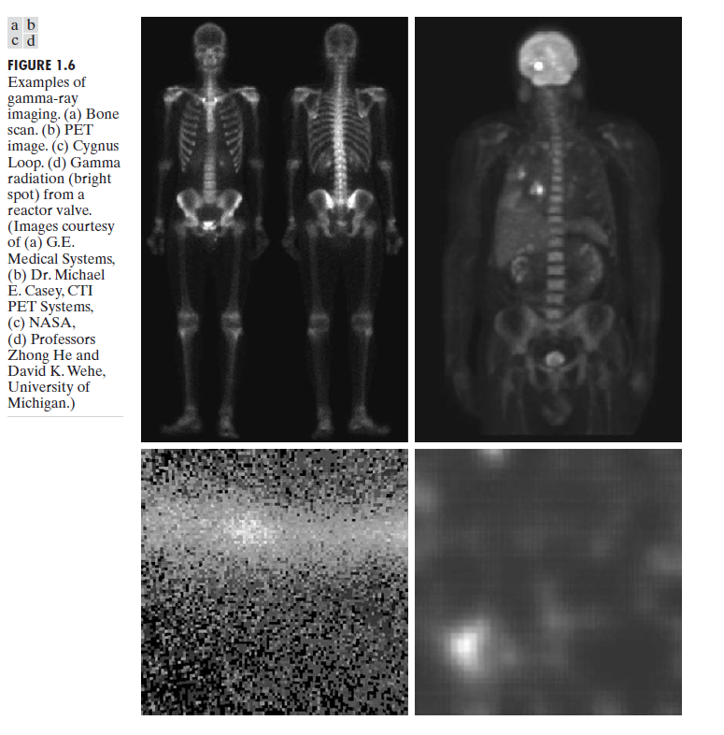
Gamma-Ray Imaging
Major uses of imaging based on gamma rays include nuclear medicine and astronomical observations.
copyright: Gonzalez & Woods

Slide 22
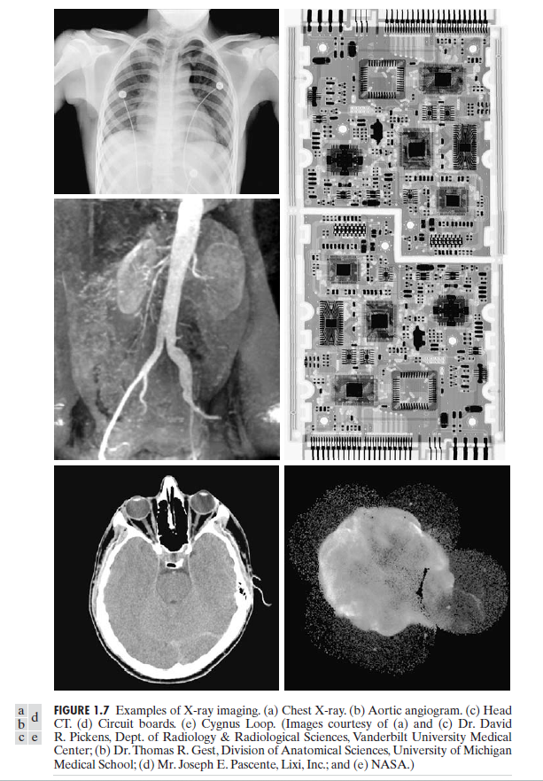
X-ray Imaging
The best known use of X-rays is medical diagnostics, but they also are used extensively in industry and other areas, like astronomy.
Angiography is another major application in an area called contrast enhancement radiography. This procedure is used to obtain images (called angiograms) of blood vessels.
Another important use of X-rays in medical imaging is computerized axial tomography (CAT).
Figure 1.7(d) shows an X-ray image of an electronic circuit board. Such images, representative of literally hundreds of industrial applications of X-rays, are used to examine circuit boards for flaws in manufacturing, such as missing components or broken traces. Industrial CAT scans are useful when the parts can be penetrated by X-rays, such as in plastic assemblies, and even large bodies, like solid-propellant rocket motors.
Figure 1.7(e) shows an example of X-ray imaging in astronomy.This image is the Cygnus Loop of Fig. 1.6(c), but imaged this time in the X-ray band.
copyright: Gonzalez & Woods

Slide 23
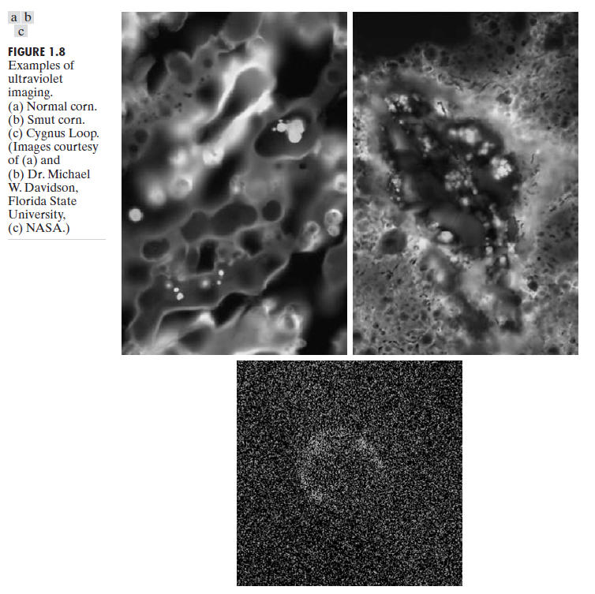
Imaging in the Ultraviolet band
Ultraviolet light is used in fluorescence microscopy, one of the fastest-growing areas of microscopy.
copyright: Gonzalez & Woods

Slide 24
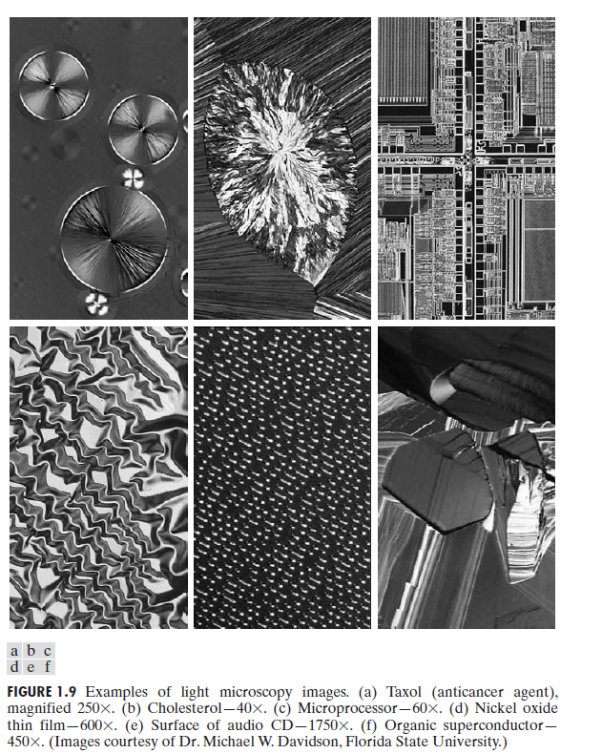
Imaging in visible and infrared bands
Figure 1.9 shows several examples of images obtained with a light microscope.
The examples range from pharmaceuticals and microinspection to materials characterization.
Another major area of visual processing is remote sensing, which usually includes several bands in the visual and infrared regions of the spectrum. The primary function of NASA’s LANDSAT satellite is to obtain and transmit images of the Earth from space for purposes of monitoring environmental conditions on the planet.
copyright: Gonzalez & Woods

Slide 25
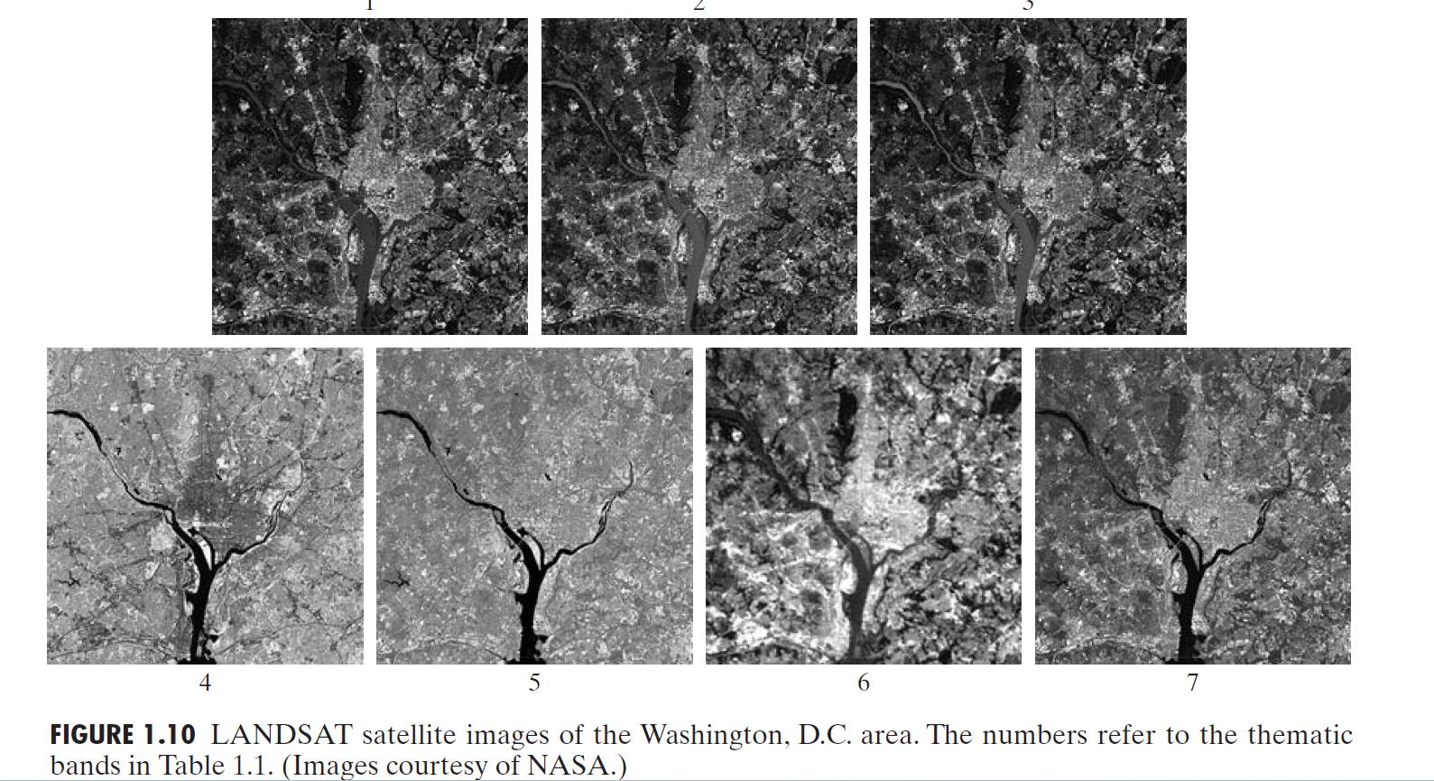
copyright: Gonzalez & Woods

Slide 26
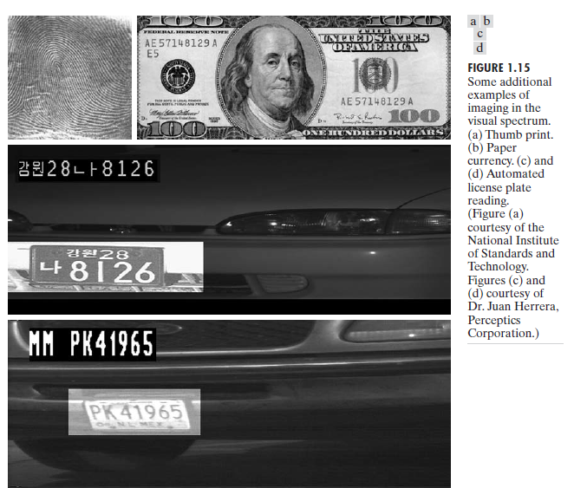
More Examples:
copyright: Gonzalez & Woods

Slide 27
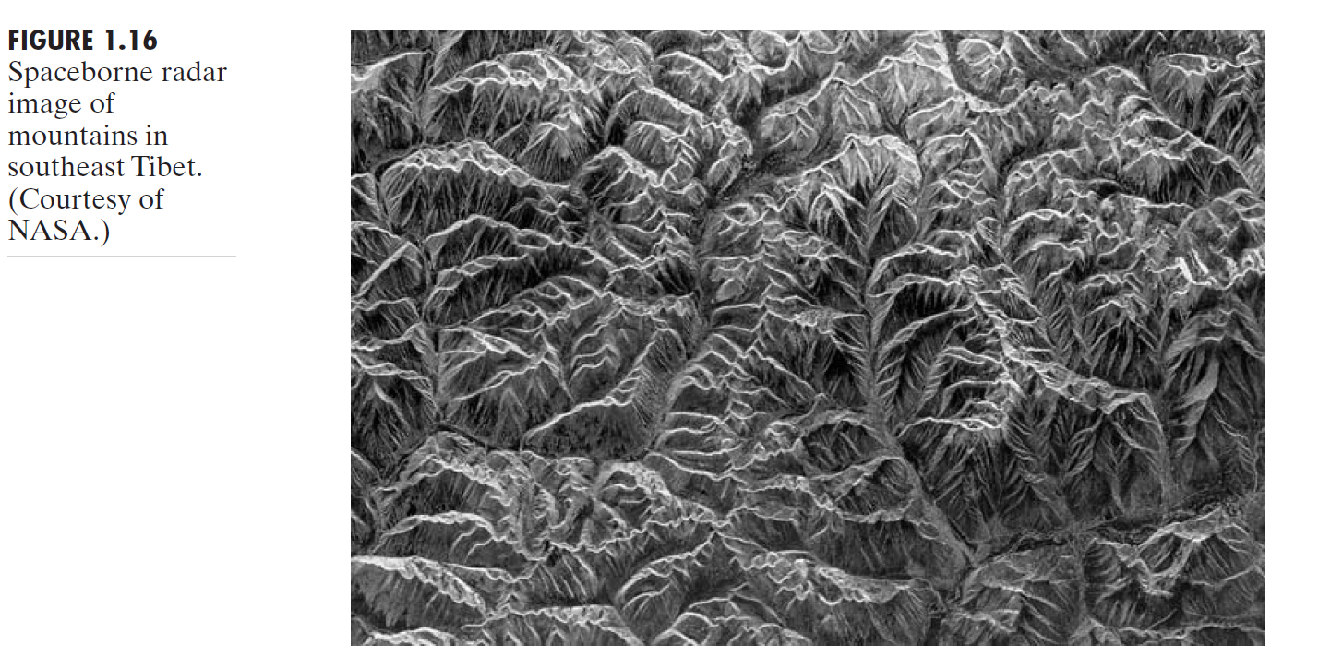
Imaging in the microwave band
The dominant application of imaging in the microwave band is radar.
The unique feature of imaging radar is its ability to collect data over virtually any region at any time, regardless of weather or ambient lighting conditions.
Some radar waves can penetrate clouds, and under certain conditions can also see through vegetation, ice, and dry sand. In many cases, radar is the only way to explore inaccessible regions of the Earth’s surface.
copyright: Gonzalez & Woods

Slide 28
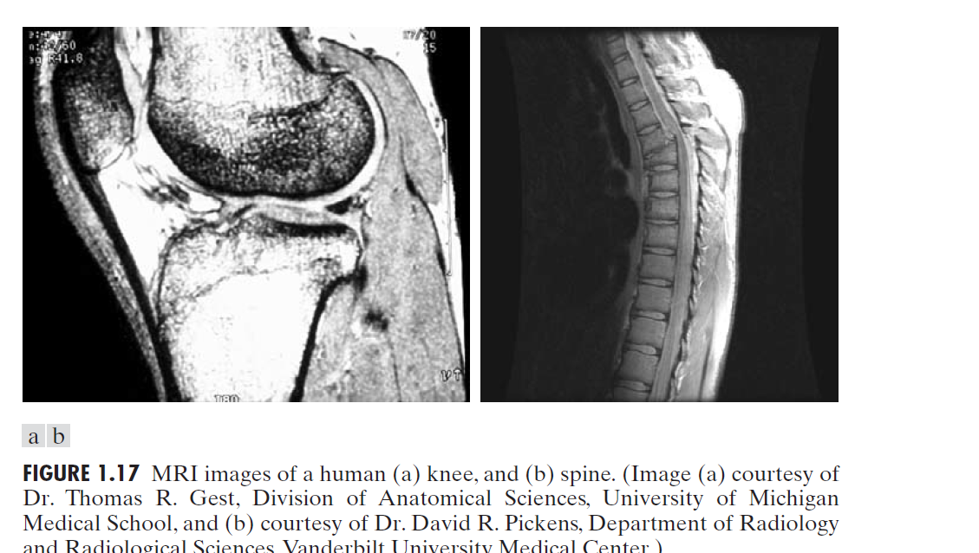
Imaging in the radio band
In medicine, radio waves are used in magnetic resonance imaging (MRI). This technique places a patient in a powerful magnet and passes radio waves through his or her body in short pulses.
Each pulse causes a responding pulse of radio waves to be emitted by the patient’s tissues. The location from which these signals originate and their strength are determined by a computer, which produces a two-dimensional picture of a section of the patient. MRI can produce pictures in any plane.
copyright: Gonzalez & Woods

Slide 29
Other imaging modalities
The most important commercial applications of image processing in geology are in mineral and oil exploration.
In a typical ultrasound image, millions of pulses and echoes are sent and received each second.
copyright: Gonzalez & Woods

Slide 30
Representing Digital Images
(a): f(x,y), x=0, 1, …, M-1, y=0,1, …, N-1
x, y: spatial coordinates → spatial domain (b): suitable for visualization
(c): processing and algorithm development
x: extend downward (rows)
y: extend to the right (columns)
Number of bits storing the image
b = M × N × k
copyright: Gonzalez & Woods

Slide 31
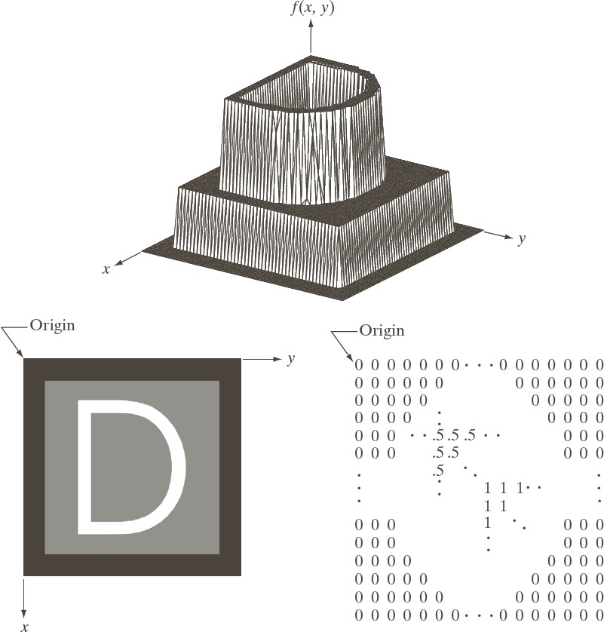
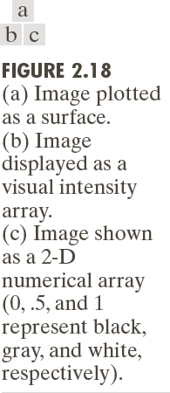
3 Ways to Represent Images
copyright: Gonzalez & Woods

Slide 32
Suppose that we sample the continuous image into a 2-D array,
f(x,y) , containing M rows and N columns,
where (x,y) are discrete coordinates.
For notational clarity and convenience, we use integer values for these discrete coordinates:
and x= 1,2,3….M-1
and y= x= 1,2,3….N-1

Slide 33
Images in the Spatial Domain
A (digital) image is defined by integrating and sampling continuous (analog) data in a spatial domain.
It consists of a rectangular array of pixels (x, y,u), each combining a location (x, y) ∈ Z² and a value u, the sample at location (x, y).
Z is the set of all integers.
We assume a left-hand coordinate system as shown in Fig. 1.1.
Row y contains grid points {(1, y), (2, y), . . . , (Ncols, y)} for 1 ≤ y ≤ Nrows, and
column x contains grid points {(x, 1), (x, 2), . . . , (x,Nrows)} for 1 ≤ x ≤ Ncols.

Slide 34
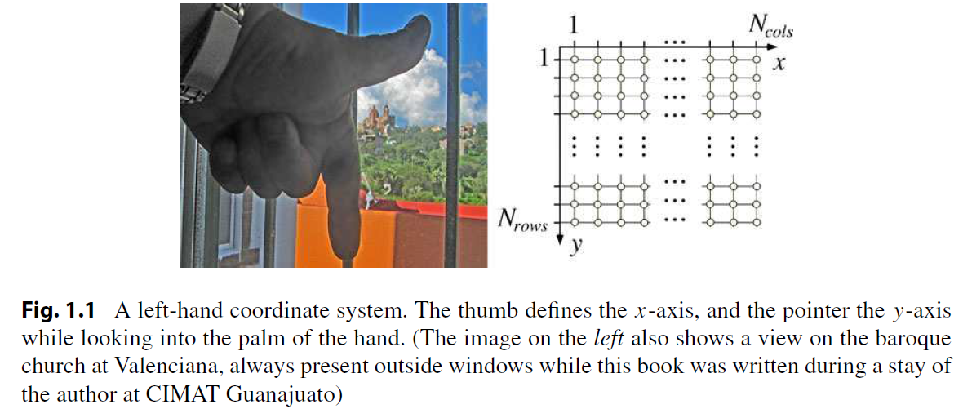
A Left-hand Coordinate System
R. Klette, Concise Computer Vision, Undergraduate Topics in Computer Science, DOI 10.1007/978-1-4471-6320-6_1, © Springer-Verlag London 2014

Slide 35
A (2D) Image
An image = a 2D function f(x,y) where
x and y are spatial coordinates
f(x,y) is the intensity or gray level
An digital image:
o
x
y
x, y, and f(x,y) are all finite
For example x ∈{1,2,…, M } , y ∈{1,2,
f (x, y) ∈{0,1,2,…,255}
Digital image processing → processing digital images by
means of a digital computer
Each element (x,y) in a digital image is called a pixel (picture element)

Slide 36
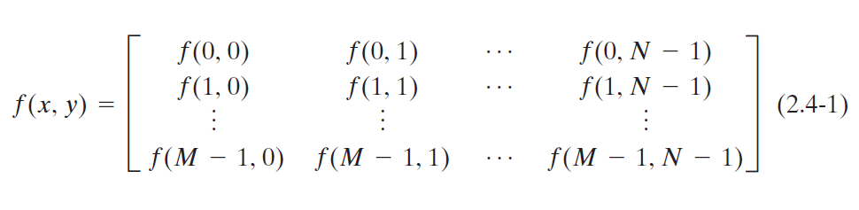
Representing Digital Images
In equation form, we write the representation of a numerical M × N array as
copyright: Gonzalez & Woods

Slide 37
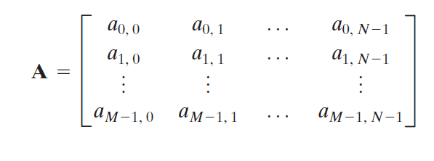
Traditional Matrix Notation
copyright: Gonzalez & Woods

Slide 38
Digital Image Formats
Read Section 2.5 From Shaprio and Stockman

Slide 40
Image Intensities:
Digital Images are represented as two-dimensional array, where each element of the Array represents individual component of the image that is called picture element Or pixel.
The number of bits used to store that value of the pixel identify the number of grey levels (or Possible grey level values) used to describe a pixel.
How many values can be stored to represent image pixel ?
Source Courtesy: https://www.allaboutcircuits.com/technical-articles/image-histogram-characteristics-machine-learning-image-processing/

Slide 41
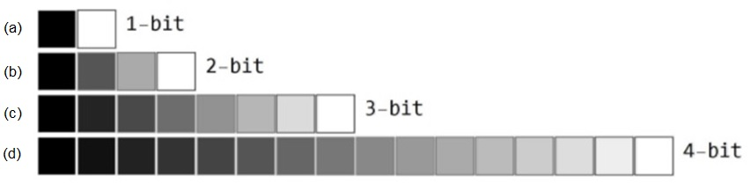
Image Intensities:
Digital Images are represented as two dimension array array, where each element of the Array represents individual component of the image that us called picture element
Or pixel (PEL).
The number of bits used to store that value of the pixel identify the number of grey levels (or Possible grey level values) used to describe a pixel.
Source Courtesy: https://www.allaboutcircuits.com/technical-articles/image-histogram-characteristics-machine-learning-image-processing/

Slide 42
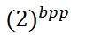
Grey Levels and Concept of Bits Per Pixel
Bits per pixel | Number of colors
1 bpp | 2 colors
2 bpp | 4 colors
3 bpp | 8 colors
4 bpp | 16 colors
5 bpp | 32 colors
6 bpp | 64 colors
7 bpp | 128 colors
8 bpp | 256 colors
10 bpp | 1024 colors
16 bpp | 65536 colors
24 bpp | 16777216 colors (16.7 million colors)
32 bpp | 4294967296 colors (4294 million colors)
This table shows different bits per pixel and the amount of color they contain.
# of Colors/grey Levels or intensity levels=

Slide 43
Calculation of total number of pixels:
We have defined an image as a two-dimensional signal or matrix. In that case, the number of PEL would equal the number of rows multiplied by the number of columns.
This can be mathematically represented as below:
Total number of pixels = number of rows ( X ) number of columns
Or we can say that the number of (x,y) coordinate pairs makes up the total number of pixels.

Slide 44
Gray Level
The value of the pixel at any point denotes the intensity of image at that location , and that is known as gray level.

Slide 45
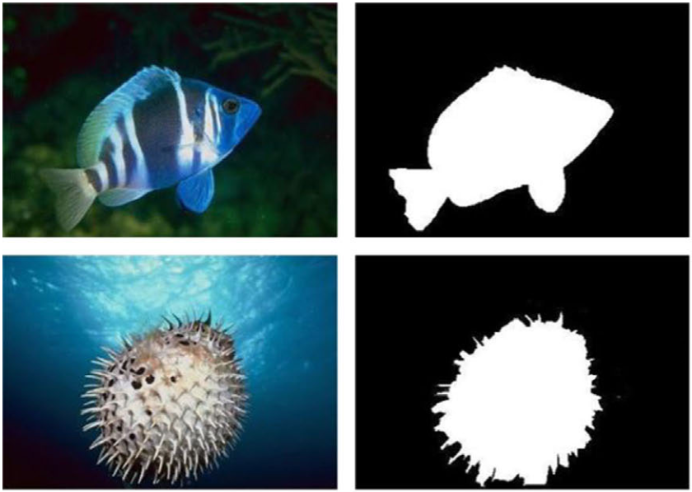
Binary Image

Slide 47
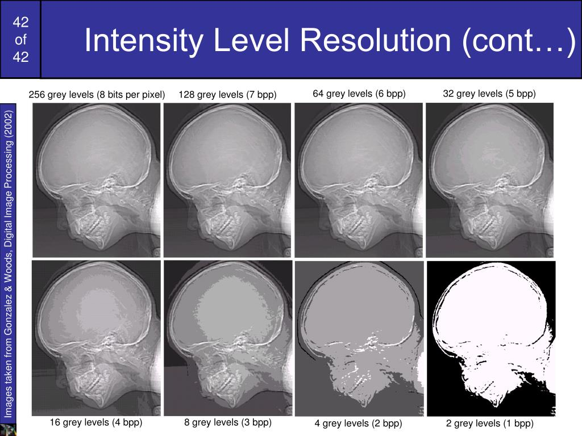
Digital Image Analysis
Image Intensities:
Gray Values:
Resolution: 452 x 354 (for all images)
copyright: Gonzalez & Woods

Slide 48
Digital Image Analysis
Image Intensities:
Gray Values:
Resolution: 452 x 354 (for all images)
copyright: Gonzalez & Woods

Slide 49
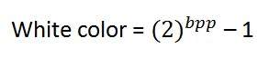
Black color: Remember , 0 pixel value always denotes black color. But there is no fixed value that denotes white color.
White color: The value that denotes white color can be calculated as :

Slide 50
Size of an image = rows * cols * bpp
= 1024 * 1024 * 8
= 8388608 bits.
But since its not a standard answer that we recognize , so will convert it into our format.
Converting it into bytes = 8388608 / 8 = 1048576 bytes.
Converting into kilo bytes = 1048576 / 1024 = 1024kb.
Converting into Mega bytes = 1024 / 1024 = 1 Mb.

Slide 51
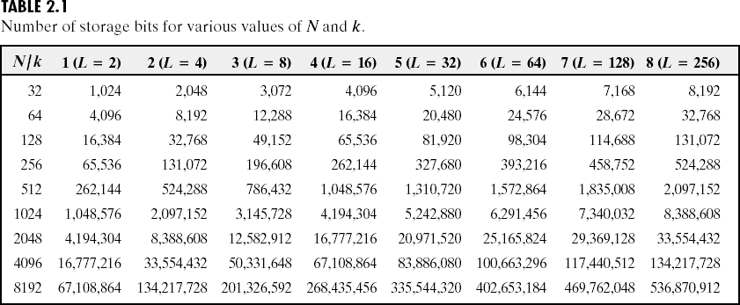
Store an Image
copyright: Gonzalez & Woods

Slide 52
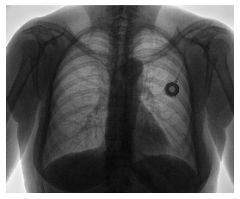
Digital Image Analysis
Image Intensities:

Slide 53
Digital Image Analysis
Image Intensities:
Intensity of Pixel [1,1]
Intensity of Pixel [3,1]
Intensity of Pixel [6,1]

Slide 54
Digital Image Analysis
Image Intensities:
Color image is composed of three channels of 2D images, where each channel
Represents RED , GREEN and BLUE (RGB) components of the image

Slide 55
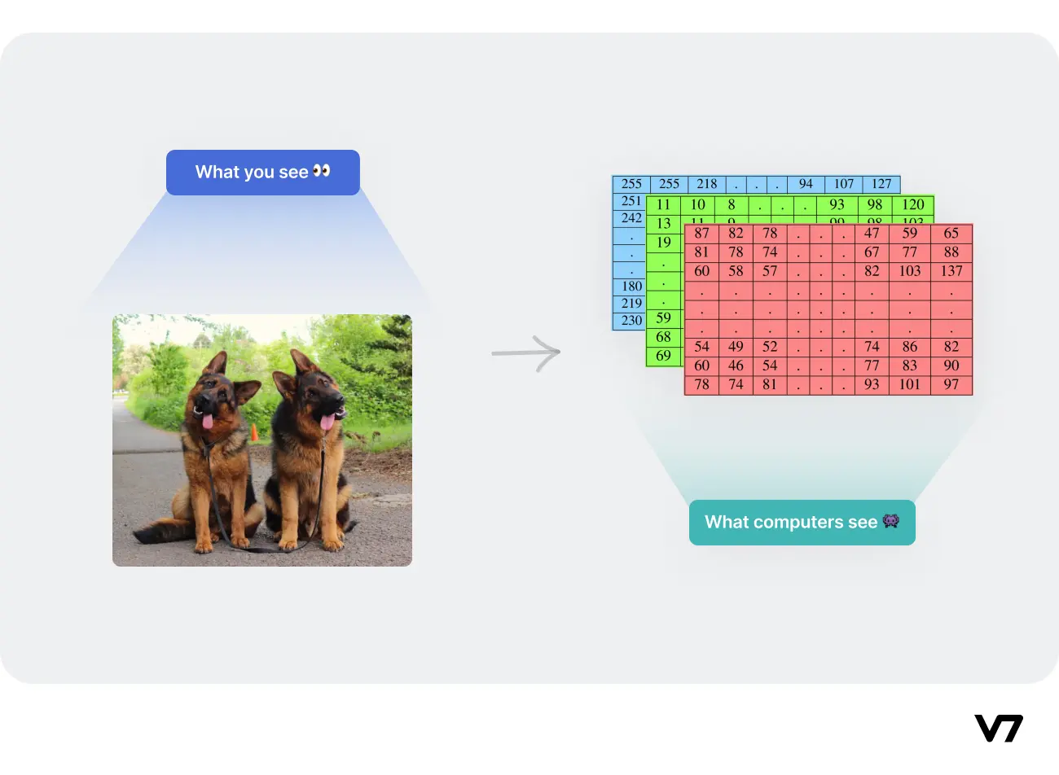

Slide 56
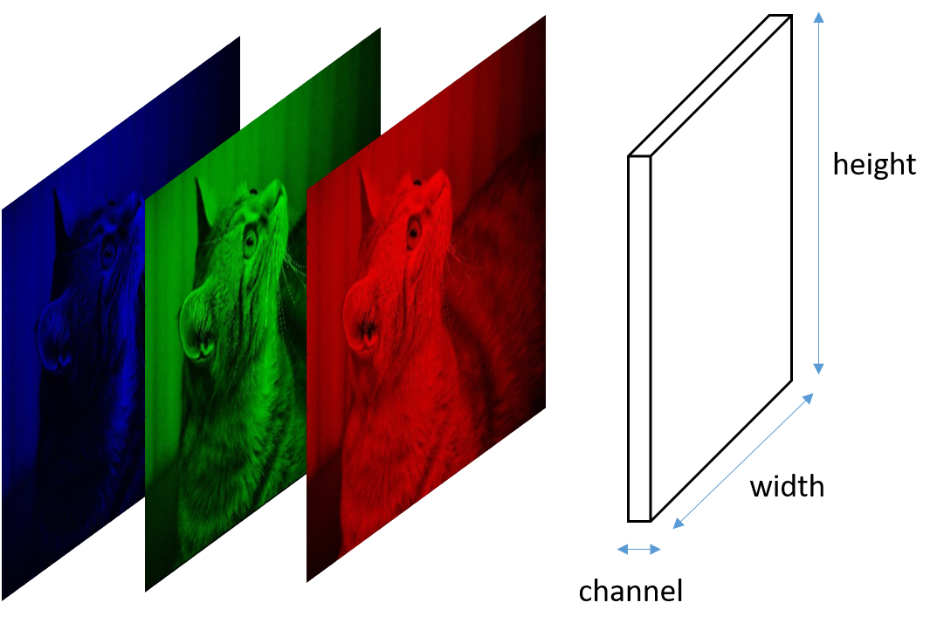

Slide 57
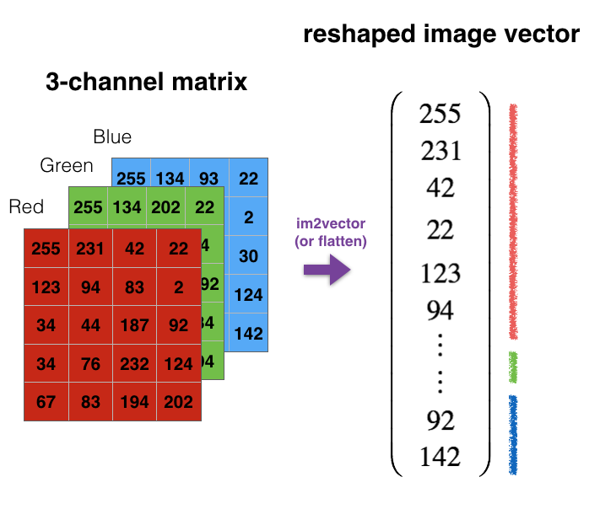

Slide 58
Color image is composed of three channels of 2D images, where each channel
Represents RED , GREEN and BLUE (RGB) components of the image
Intensity of Pixel [1,1,1]
R, G , B
P (255, 255, 255)

Slide 59
Digital Image Analysis
Image Intensities:
Color image is composed of three channels of 2D images, where each channel
Represents RED , GREEN and BLUE (RGB) components of the image
180
70
P (230, 70, 180)
230

Slide 60
Decimal Code for Color red ?
(255,0,0)
For Green?
For Blue?
For Grey?

Slide 61
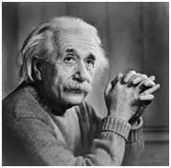

Image Processing
Input
Output
Process

Slide 62
Image Analysis
210
Input
In Memory Image
Read Image
178

Slide 63
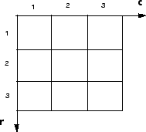
Digital Image Analysis
How we can process images using computers?
C
R
I [2,3] access pixel value from second row and third column.

Slide 64
Image Analysis
I [2,3] access pixel value from second row and third column.

Slide 65
Image Analysis
f( x, y ) gives the intensity at position ( x, y ) with a finite range:
f: [a,b]x[c,d] [0,1]
A color image is just three functions pasted together.
f (x,y) = [ f_{r}(x,y) , f_{g}(x,y) , f_{b}(x,y) ]

Slide 66
Image Analysis
Image processing usually defines a new image in terms of the existing
Image f.
i.e. f ^{ꞌ} (x,y) = g ( f (x,y) )
Is an example of a simple operation that transforms each pixel individually.

Slide 67
Convert color image to Greyscale Image.
Example : Convert color image to Greyscale Image.
f ^{ꞌ} (x,y) = g ( f (x,y) )
Where f ꞌ (x,y) is the greyscale image and f in representing color image,
Whereas g is a function that is used to convert color image to greyscale.

Slide 68
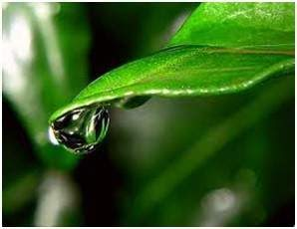

Digital Image Analysis
Example : Convert color image to Greyscale Image.
f ^{ꞌ}= g ( f (x,y) )
f
f’
Image Courtesy: https://www.tutorialspoint.com/dip/grayscale_to_rgb_conversion.htm

Slide 69

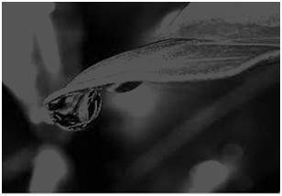
Colored to grey scale image

Slide 70
Average method
Its done in this way.
Grayscale = (R + G + B) / 3

Slide 71
Problem?

Slide 72
Luminosity Method
Since red color has more wavelength of all the three colors , and green is the color that has not only less wavelength then red color but also green is the color that gives more soothing effect to the eyes.
It means that we have to decrease the contribution of red color , and increase the contribution of the green color , and put blue color contribution in between these two.
New grayscale image = ( (0.3 * R) + (0.59 * G) + (0.11 * B) ).

Slide 73

Difference?

Slide 74
Resolution
Pixel Resolution
Spatial Resolution
Intensity Resolution

Slide 75
Pixel Resolution
Resolution refers to the total number of count of pixels in a digital image.
For example. If an image has M rows and N columns , then its resolution can be defined as M X N

Slide 76
Spatial Resolution
Spatial resolution can be defined as the smallest discernible detail in an image.

Slide 77
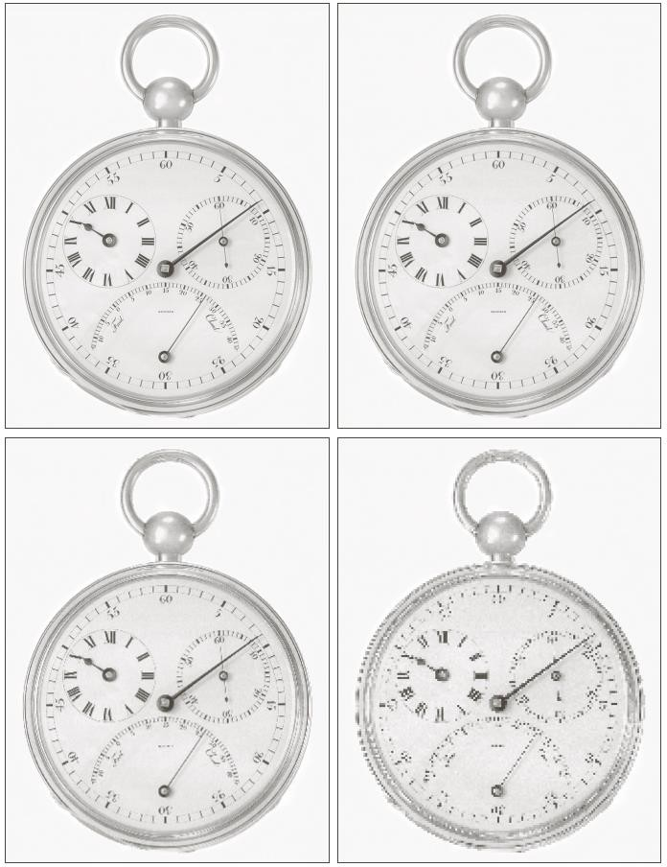
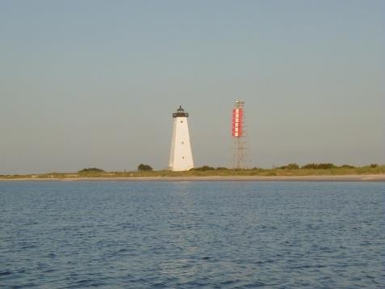
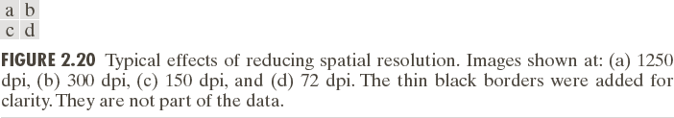
Spatial Resolution
Spatial resolution: smallest discernible details
# of line pairs per unit distance
# of dots (pixels) per unit distance
Printing and publishing
In US, dots per inch (dpi)
Newspaper magazines book
Large image size itself does not mean high spatial resolution!
Scene/object size in the image
1280*960
http://www.shimanodealer.com/fishing_reports.htm

Slide 78
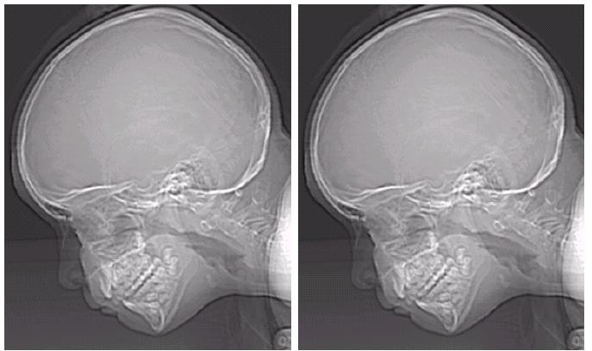
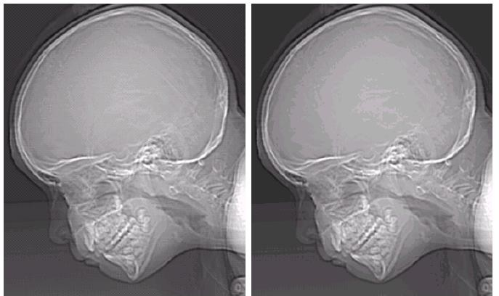


Intensity Resolution
Smallest discernible change in intensity levels
Using the number of levels of intensities
False contouring (banding) when k is small - undersampling
256
128
64
32
16
8
4
2

Slide 79



Isopreference Curves
Vary the spatial and intensity sampling
simultaneously:

Slide 80
Mathematics of Image Processing

Slide 81






Basic Set and Logical Operations

Slide 82
Set Operations Based on Coordinates
A region in an image is represented by a set of coordinates within the region

Slide 83



Some Basic Relationships between Pixels
Neighbors of a pixel
 | (x-1,y)
(x,y-1) | (x,y) | (x,y+1)
 | (x+1,y)
(x-1,y-1) | (x-1,y+1)
(x,y)
(x-1,y+1) | (x+1,y+1)
(x-1,y-1) | (x-1,y) | (x-1,y+1)
(x,y-1) | (x,y) | (x,y+1)
(x-1,y+1) | (x+1,y) | (x+1,y+1)

Slide 84








Adjacency
Adjacency is the relationship between two pixels p and q
V is a set of intensity values used to define adjacency
Binary image: V={1} or V={0}
Gray level image:
Intensity constraints
Three types of adjacency:
4-adjacency 8-adjacency
m-adjacency
X
p
and

Slide 85
Mathematic Tools
Array/Matrix operations
Linear/nonlinear operations
Linearity:
Arithmetic Operations – single pixel operations
Image averaging, image subtraction, image multiplication
Set and logic operations Spatial operations
Single pixel operations and neighborhood operations
Image transformation Probabilistic methods

Slide 86
Mathematic Tools
Array versus Matrix operations
Array Multiplications
^{𝒂}𝟏𝟏
^{𝒂}𝟐𝟏
^{𝒂}𝟏𝟐
^{𝒂}𝟐𝟐
^{𝒃}𝟏𝟏
^{𝒃}𝟐𝟏
^{𝒃}𝟏𝟐
^{𝒃}𝟐𝟐
^{𝒂}𝟏𝟏^{𝒃}𝟏𝟏
^{𝒂}𝟐𝟏^{𝒃}𝟐𝟏
^{𝒂}𝟏𝟐^{𝒃}𝟏𝟐
^{𝒂}𝟐𝟐^{𝒃}𝟐𝟐
=
Matrix Multiplications
^{𝒂}𝟏𝟏
^{𝒂}𝟐𝟏
^{𝒂}𝟏𝟐
^{𝒂}𝟐𝟐
^{𝒃}𝟏𝟏
^{𝒃}𝟐𝟏
^{𝒃}𝟏𝟐
^{𝒃}𝟐𝟐
^{𝒂}𝟏𝟏^{𝒃}𝟏𝟏 ^{+ 𝒂}𝟏𝟐^{𝒃}𝟐𝟏
^{𝒂}𝟐𝟏^{𝒃}𝟏𝟏 ^{+ 𝒂}𝟐𝟐^{𝒃}𝟐𝟏
^{𝒂}𝟏𝟏^{𝒃}𝟏𝟐 ^{+ 𝒂}𝟏𝟐^{𝒃}𝟐𝟐
^{𝒂}𝟐𝟏^{𝒃}𝟏𝟐 ^{+ 𝒂}𝟐𝟐^{𝒃}𝟐𝟐
×
=

Slide 87



Image Averaging – Noise Reduction
Assumption: the noise is uncorrelated in image and has zero mean

Slide 88

Image Subtraction – Enhance Difference

Slide 89


Image Subtraction
The images used in averaging & subtraction must be registered!

Slide 90


Image Multiplication (Division)
g(x,y)=f(x,y)h(x,y)
g(x,y)=f(x,y)/h(x,y)

Slide 91
The images used in averaging & subtraction must be
registered!
Notes on Arithmetic Operations
Output images should be normalized to the range of [0,255]
f_{m} = f − min( f )
f_{s} = K[ f_{m} / max( f_{m} )]

Slide 92


Set Operations Based on Intensities
Complement – negative image
𝑨^{𝒄} = 𝒙, 𝒚, 𝑲 − 𝒛 𝒙, 𝒚, 𝒛 ∈ 𝑨
Thresholding
𝑨 𝖴 𝑩 = 𝒙, 𝒚, max 𝒛_{𝒂}, 𝒛_{𝒃}
𝒙, 𝒚, 𝒛_{𝒂} ∈ 𝑨, 𝒙, 𝒚, 𝒛_{𝒃} ∈ 𝑩

Slide 93


Logic Operations for Binary Image
Foreground/background
Binary image: 0/1
Fuzzy set: [0,1]
Logic operations will be used a lot in
morphological image processing

Slide 94
Spatial Operations
Perform directly on the pixels of the given image
Intensity transformation – change the intensity
Single pixel operations s=T(z)
Neighborhood operations
Geometric spatial transformations – change the coordinates

Slide 95


Single pixel operations
Determined by
Transformation function T
Input intensity value
Not depend on other pixels and position

Slide 96


Neighborhood Operations
Image smoothing
g( x, y) =
1
∑ f (r, c)
^{mn} ( r,c )∈S
xy
Other examples:
Interpolation
Image filtering

Slide 97
Interpolation
Nearest Neighbor Interpolation
Linear Interpolation
Bilinear Interpolation

Slide 98
Image preprocessing
Image Corrections
Sensor
Lightning
Noise
Geometric
Color

Slide 99
Computer vision systems are commonly highly dependent on the quality of the incoming images.
Image acquisition can often be improved, particularly for inspection applications, by arranging regions of nearly uniform illumination so that shadows and glints are suppressed, and vision algorithms can be simplified and speeded up.

Slide 100
Enhancement
Whitening (contrast)
Histogram equalization
Linear Filtering (Blurring)

Slide 101
Read
Chapter 1, 2 Gonzalez, Rafael C. Digital image processing. Pearson education India, 2009.

